Slide 1
CHRONIC KIDNEY DISEASE DETECTION USING ENSEMBLE LEARNING
Dhaush uppala pati

Slide 2

Introduction:
The project, titled "Chronic Kidney Disease Detection Using Ensemble Learning," focuses on predicting Chronic Kidney Disease with high accuracy using machine learning. By employing algorithms such as K-Nearest Neighbor, Naïve Bayes, and others, alongside advanced ensemble techniques, the study achieves around 99% prediction accuracy. This work underscores the potential of applying machine learning to enhance healthcare diagnostics with a streamlined set of features.

Slide 3
Reference Paper:
Title: Chronic Kidney Disease Detection using AdaBoosting Ensemble Method and K-Fold Cross Validation
Author: N.Mohana Suganthi, Jemin V.M, P.Rama
Year: 07 February 2023
Journal Name: IEEE Xplore (Click here for Reference paper)
Why I choose this paper:I selected this paper for its detailed exploration of AdaBoost ensemble learning and K-Fold Cross Validation in CKD detection, aligning with my project's aim for high predictive accuracy. It offers practical insights into enhancing machine learning models for healthcare, demonstrating significant success with a 99% accuracy rate using AdaBoost-Random Forest, which directly informs and supports the methodologies applied in my work.
Models used in this project: The paper utilizes AdaBoost with ensemble methods like Random Forest for Chronic Kidney Disease prediction, employing K-Fold Cross Validation for accuracy assessment.
Other References:

Slide 4
RELATED WORKS:
TITLE: Detection of chronic kidney disease by using ensemble classifiers|IEEE
Authors :Merve Dogruyol Basar, Aydin Akan
year: 2018
Journal name: IEEE
Method:
Several classification and feature selection methods are considered for the detection of CKDs in the literature. Generally, k-NN, SVM, decision trees (J48, BFTree, REPTree), Gauss algorithm based classifiers as well as Naïve Bayes classifiers are used . For example, Baby et al. showed that the best methods in terms of classification accuracy are KStar, RandomForest and J48 algorithms. In this paper, chronic kidney diseases are classified by using various features and classifiers combination. Initially, four individual classifiers are applied to 24 features and best result are obtained using individual J48tree classifier as 99%. Then, ensemble classifiers are applied to the same features. Bagging and RSM J48tree classifiers resulted the best accuracy values as 100% for 24 features.

Slide 5
Related works:
Title: Chronic kidney disease prediction using boosting techniques based on clinical parameters|PLOS ONE
Authors: Shahid Mohammad Ganie,Pijush Kanti Dutta Pramanik,Saurav Mall,Zhongming Zhao
Year: 2023
Journal : Plos One
Methodology:Ensemble learning is a method that combines different traditional machine learning approaches to enhance the performance of the prediction model .Various ensemble learning approaches are proposed.Boosting algorithm is one of the effective approaches in the ensemble learning family. In the literature, several boosting algorithms can be found .In this experiment, specifically for CKD prediction, we considered the following five ensemble learning based boosting algorithms

Slide 6

Problem Statement
This initiative seeks to refine the prediction methods for Chronic Kidney Disease (CKD) by employing advanced ensemble learning methods. CKD is a critical health issue marked by a slow but steady decline in kidney functionality, which often escapes early detection due to the lack of pronounced symptoms. The project's ambition is to harness a combination of sophisticated machine learning techniques to construct a highly accurate predictive model. This model is expected to identify CKD with exceptional precision, utilizing a concise array of indicators, thereby contributing to improved early detection and management strategies in medical practice.

Slide 7
Dataset Overview:
The dataset on kidney disease comprises 400 entries with 26 attributes each, blending clinical, demographic, and laboratory data pertinent to kidney function and disorders. Attributes include patient age, blood pressure, specific gravity of urine, levels of albumin, sugar, red and pus cells, hemoglobin, and more, alongside the presence of conditions like hypertension, diabetes, and anemia. It features both numerical and categorical data, with some missing values across various columns. Primarily, it categorizes patients into those with chronic kidney disease (CKD) and those without, serving as a valuable resource for analyzing kidney health indicators and potentially developing predictive models for CKD.
Features include: Age Blood pressure Specific gravity of urine Albumin levels Sugar levels Red and pus cells in the urine Hemoglobin count
Additionally, it notes the presence of conditions such as: Hypertension Diabetes Anemia
Click here for Dataset

Slide 8

Motivation
The project is driven by the objective to enhance the precision in diagnosing Chronic Kidney Disease (CKD) through sophisticated ensemble machine learning models. The focus is on early and reliable detection due to CKD's subtle onset, aiming to prevent its progression to critical stages. By targeting a near-perfect accuracy with fewer diagnostic indicators, the initiative aspires to equip medical professionals with a powerful tool for better patient care, promoting timely interventions and improving health outcomes for those at risk of CKD.

Slide 9
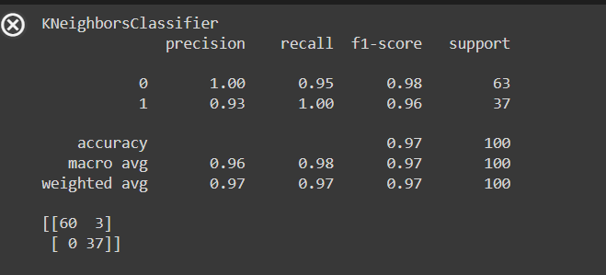
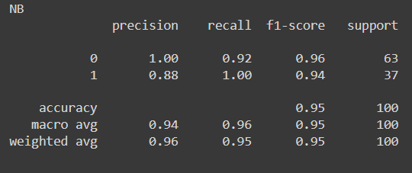
Models used:
1.K-Nearest Neighbors (KNN) classifier: The KNN model is created and trained on the `x_train` and `y_train` datasets. It then predicts class labels for the `x_test` dataset. The performance of the model is evaluated by computing a classification report, which includes precision, recall, and F1-score for each class, as well as the overall accuracy. Additionally, a confusion matrix (`cmknn`) is generated to visualize the classification accuracy for each class. Detailed performance metrics, including precision, recall, F1-score, and support (the number of actual occurrences of each class in `y_test`), are calculated for each class and the total average. These metrics are compiled into a DataFrame `all_df`, which is then used to plot the precision, recall, and F1-score for each class using the `metrics_plot` function, which displays these metrics in a bar plot format. Finally, overall accuracy, precision, recall, and F1-score for the entire dataset are printed, providing a comprehensive view of the classifier's performance.
Accuracy Result: 97.00% Precision Result: 96.25% Recall Result: 97.62% F1-Score Result: 96.83%
2. Gaussian Naive Bayes model: The process starts by initializing the Gaussian Naive Bayes classifier (`NB`) and training it with training data (`x_train` and `y_train`). After training, the model predicts the class labels for the test dataset (`x_test`), and these predictions are used to evaluate the model's performance.The evaluation includes printing the classification report, which provides key metrics such as precision, recall, and F1-score for each class, as well as the overall accuracy calculated through the `accuracy_score` function. Detailed metrics for each class and the average across all classes are also computed using the `precision_recall_fscore_support` function, which provides flexibility to handle cases where a class is not predicted (handled by `zero_division=1`).
Accuracy Result: 95.00% Precision Result: 94.05% Recall Result: 96.03% F1-Score Result: 94.77%

Slide 10
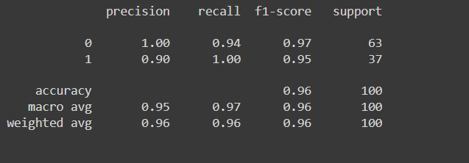
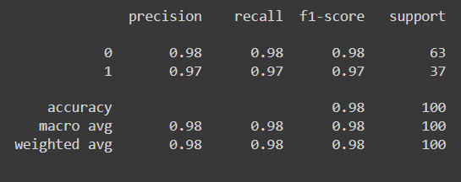
Models used:
3.LightGBM classifier: A popular gradient boosting framework that uses tree-based learning algorithms..For visualization, the `metrics_plot` function is utilized to create bar plots displaying the Precision, Recall, and F1-Score for each class using the seaborn library. This function formats the plots with labels and annotations for clarity and aesthetic appeal, omitting y-axis labels to simplify the visual presentation.Finally, the script prints a summary of overall performance metrics, including accuracy, precision, recall, and F1-score for the entire dataset, providing a clear and concise evaluation of how well the LightGBM model performed on this particular classification task.
Accuracy Result: 96.00% Precision Result: 95.12% Recall Result: 96.83% F1-Score Result: 95.80%
4. AdaBoostClassifier module: The AdaBoost (Adaptive Boosting) model is fitted with training data (`x_train`, `y_train`) to enhance its performance iteratively by focusing on incorrectly classified instances in previous iterations. After training, the model predicts labels for the test dataset (`x_test`). The predictions are then evaluated against actual labels (`y_test`) using the `classification_report`, which provides metrics like precision, recall, and F1-score for each class. The overall model accuracy is calculated with `accuracy_score`. Detailed metrics for individual classes and the macro average are compiled into a DataFrame, enabling visual assessment through bar plots that show the performance of AdaBoost across different classes in terms of precision, recall, and F1-score. The script concludes with printed statements summarizing the overall performance metrics of the model, providing insights into its effectiveness in the classification task.
Accuracy Result: 98.00% Precision Result: 97.85% Recall Result: 97.85% F1-Score Result: 97.85%

Slide 11
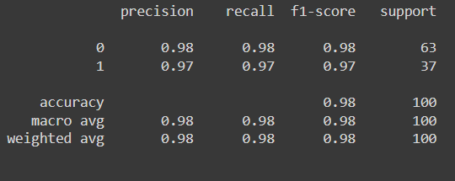
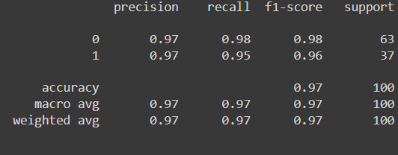
Models used:
5. Decision Tree Classifier: The Decision Tree Classifier is a type of supervised learning algorithm predominantly used in classification tasks. It operates by recursively splitting the data into smaller subsets based on specific, decision-making conditions, thus constructing a tree-like model of decisions. At each node of the tree, the algorithm chooses the feature that results in the most significant information gain, which effectively segregates the data into the most homogenous or distinct groups possible. This process continues until a stopping criterion is met, which might be a maximum depth of the tree, a minimum number of samples per leaf, or other parameters that prevent overfitting. Decision trees are valued for their simplicity and interpretability, as they mimic human decision-making processes and can be visualized, allowing easy communication of how decisions are made.
Accuracy Result: 98.00% Precision Result: 97.85% Recall Result: 97.85% F1-Score Result: 97.85%
6. Logistic Regression: The decision about class membership is made based on a threshold value, typically 0.5; if the predicted probability is higher than 0.5, the input is assigned to class 1, otherwise to class 0. Logistic Regression is favored for its simplicity and efficiency, and because it provides not only classification results but also the probabilities underlying those classifications, which can be crucial for decision-making where uncertainty needs to be quantified. The model is robust to small noise in the input data and is relatively easy to implement and interpret, making it a popular choice for many binary classification problems.
Accuracy Result: 97.00% Precision Result: 97.05% Recall Result: 96.50% F1-Score Result: 96.76%

Slide 12
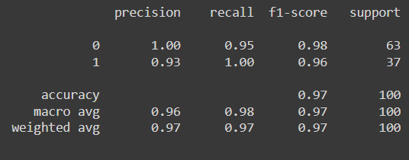
Models used:
7.MLP: Multilayer Perceptron Classifier is a type of feedforward artificial neural network that models complex relationships in data through multiple layers of nodes or neurons, where each node is connected to all nodes in the previous and subsequent layers, except for the input nodes. MLP employs backpropagation for training, effectively adjusting the weights of the neurons through gradient descent to minimize the error in predictions. Each neuron in these layers applies a nonlinear activation function to the inputs it receives, which introduces nonlinearity to the model, allowing it to learn more complex patterns than a simple linear classifier could. MLPs are highly versatile and can be used for a range of tasks from simple binary classification to more complex function approximation tasks, making them powerful tools in the machine learning practitioner's toolkit.
Accuracy Result: 98.00% Precision Result: 97.44% Recall Result: 98.41% F1-Score Result: 97.88%

Slide 13
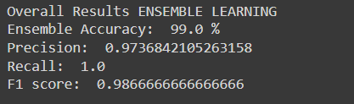
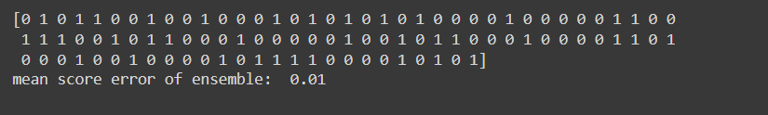
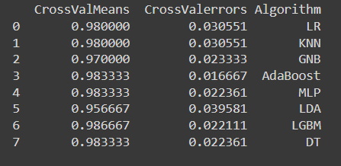
Overall results of ensemble learning:
Ensemble learning results:
Mean score error:

Slide 14
Key learnings:
Versatility of Machine Learning Models: The project utilized a variety of machine learning algorithms, including KNN, Naïve Bayes, LDA, LightGBM, AdaBoost, Decision Tree, Logistic Regression, and MLP. This diverse toolkit allowed for a comprehensive analysis of which models performed best under certain conditions and with specific types of data.
Effectiveness of Ensemble Techniques: Implementing ensemble techniques significantly enhanced the prediction accuracy, achieving about 99% accuracy in detecting CKD. This demonstrates the power of combining multiple machine learning models to improve predictive performance, particularly in complex tasks like medical diagnoses.
Importance of Data Pre-processing: The project emphasized the necessity of careful data collection and pre-processing to ensure the quality and reliability of the model's predictions. This involved handling real-world data complexities such as missing values and variance in data formats.
Application in Healthcare: Applying machine learning to healthcare, specifically in predicting CKD, showed potential for developing efficient tools that assist in early diagnosis and management, potentially improving patient outcomes.
User-Centric Design: The creation of a user-friendly web interface for healthcare professionals to input patient data highlighted the project's focus on practical application, making it accessible and usable in real-world settings.
Cross-Validation and Model Selection: The use of stratified K-fold cross-validation ensured that the model was robust and performed consistently across different subsets of the dataset. This was crucial in selecting the best-performing model, which was the LGBM, based on its superior accuracy and efficiency.
These learnings not only highlight the technical achievements and challenges of the project but also underscore the transformative potential of machine learning in enhancing healthcare diagnostics.

Slide 15
Future works:
Explainable AI: Incorporating explainable AI components to help medical professionals understand how predictions are made, which features are most important, and why specific decisions are suggested. This transparency is crucial for trust and adoption in clinical settings.
Deployment and Scalability: Testing the system's scalability and performance in a real-world clinical environment could be another focus. Addressing deployment challenges and ensuring the model performs well on a large scale across different populations and settings would be crucial.
Patient Engagement Tools: Developing applications or tools that allow patients to input their health data and receive personalized risk assessments or health suggestions could empower patients and encourage proactive management of their health.

Slide 16

:
In conclusion, this project aimed to develop a predictive model for the occurrence of Chronic disease in patients using various features. A dataset consisting of 303 records and 14 features was utilized, including age, sex, chest pain type, blood pressure, cholesterol level, and more. Machine learning algorithms such as KNN, Naive Bayes, LDA, LGBM, AdaBoost, DT, LR, and MLP were employed for prediction. The performance of each algorithm was evaluated through K-fold cross validation, and the LGBM algorithm was selected based on its superior performance.

Slide 17

j

